Slide 1
Welcome

Slide 2
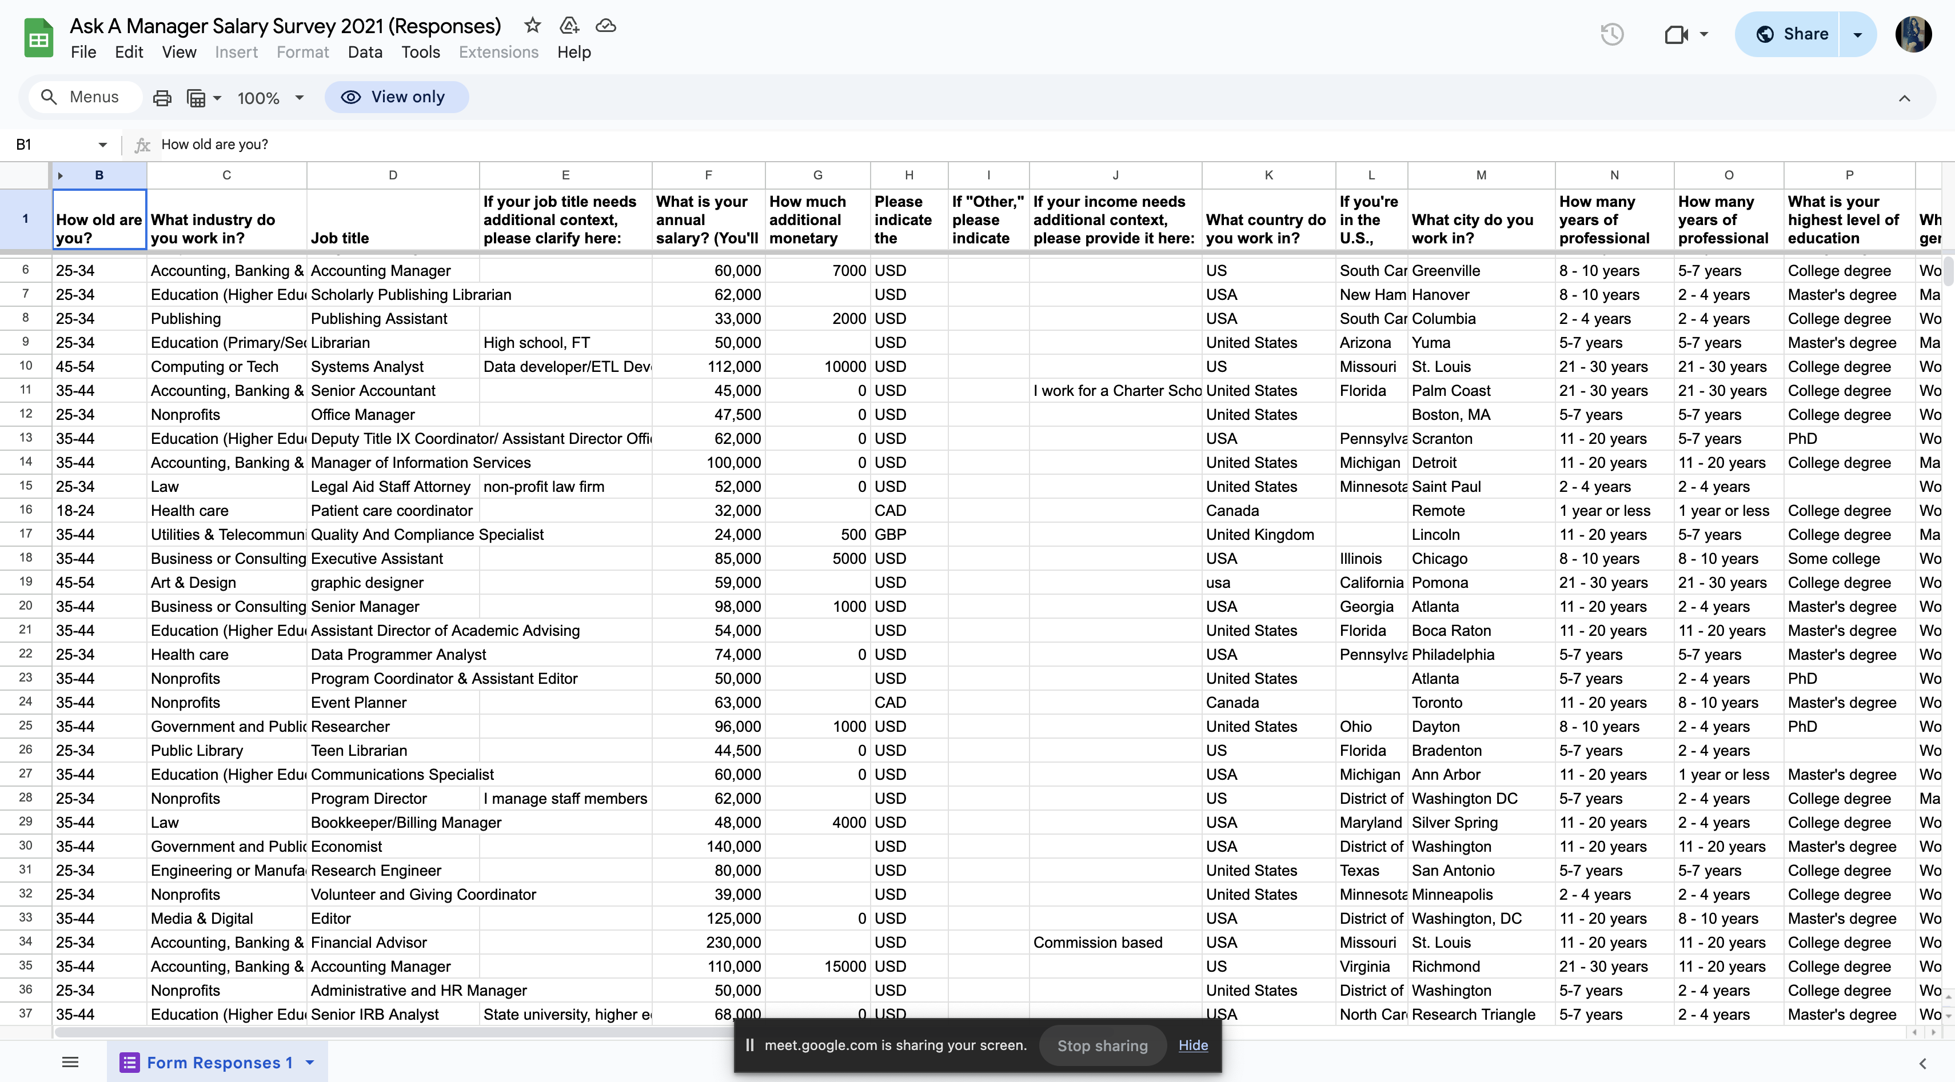
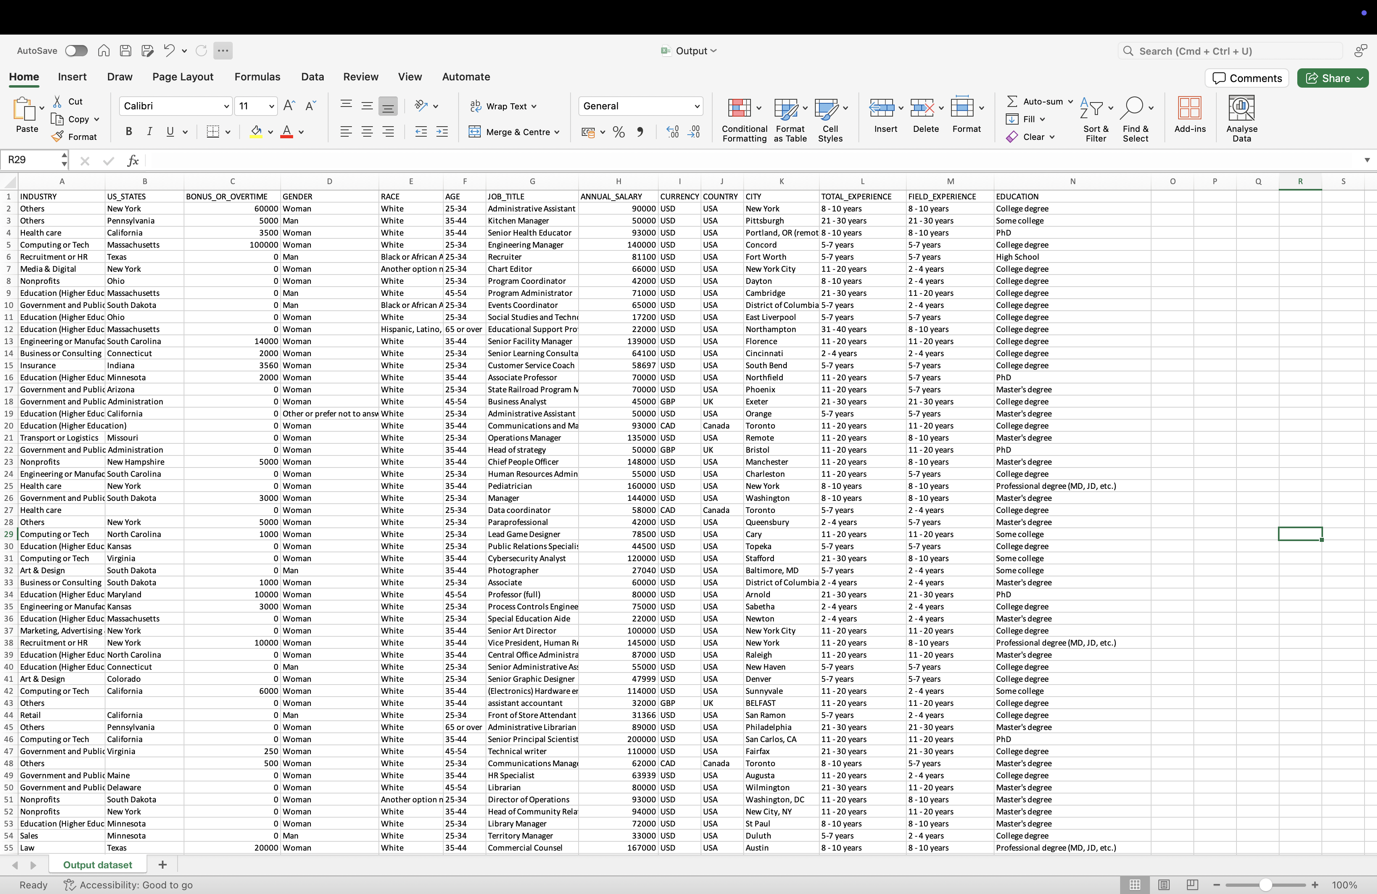
Data Cleaning & Storytelling: A Journey Through the Employment Dataset
Raw & uncleaned Dataset
Cleaned Dataset
By, Samiksha Dhere
Piyush Kulkarni

Slide 3
Introduction
Objective of the Project:
Clean and analyse the Employment dataset.
Uncover patterns in salary distributions, job roles, demographics, and geographical trends.
Overview of Data:
Dataset includes 14 columns on industry, location, job title, demographics, salary, and experience.

Slide 4
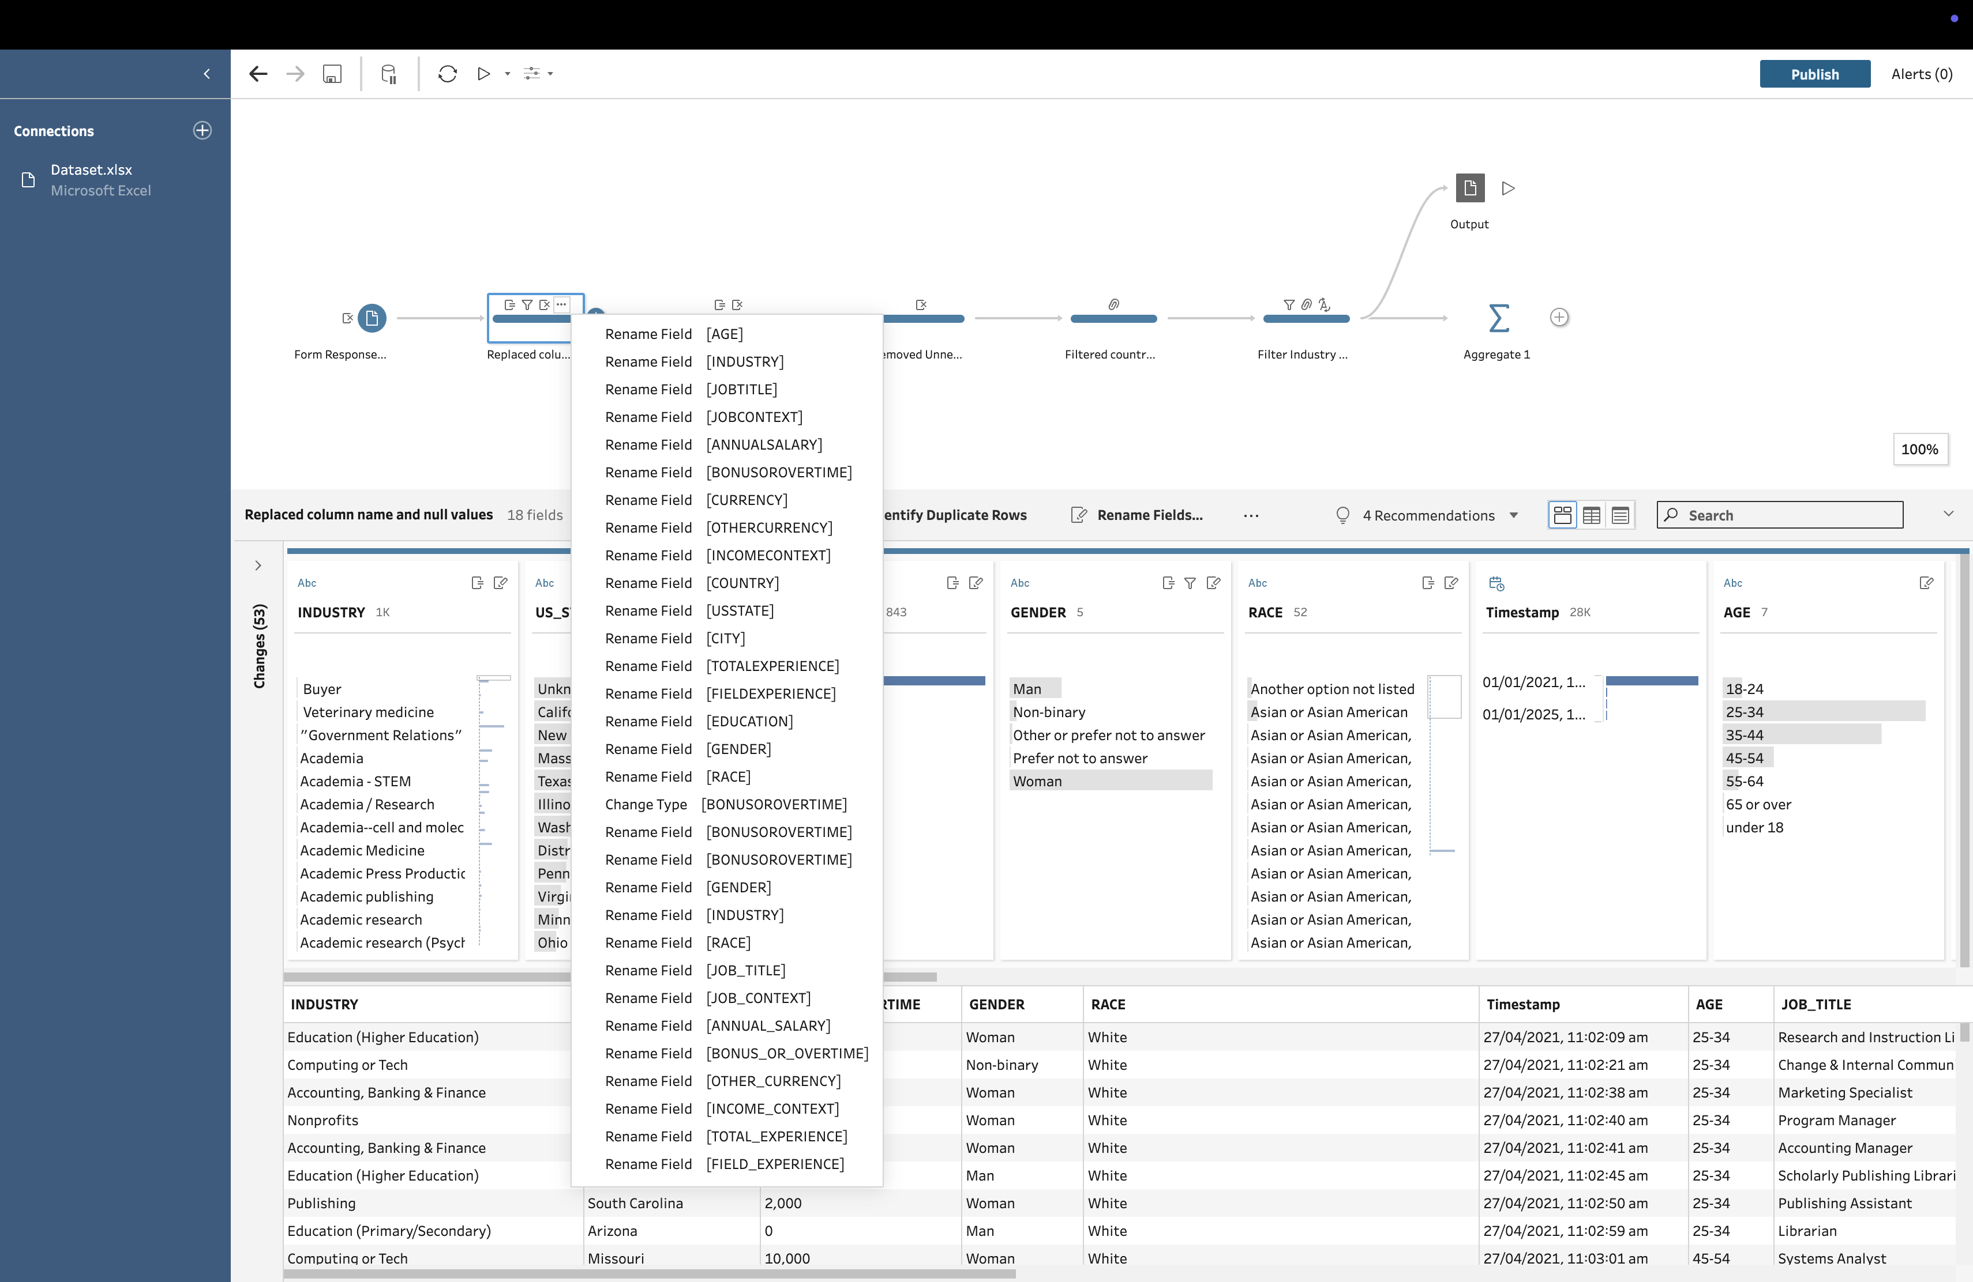
Objectives of Data Cleaning
Goal of Data Cleaning:
Ensure accuracy, consistency, and completeness for reliable analysis & visualization of the dataset.
Specific Cleaning Goals:
Standardize various columns, removing "Unknown" values and replacing “Null values”.
Format salary and experience fields for numerical interpretation.
Address missing values and handle outliers.

Slide 5
Benefits
Stakeholders Benefiting:
Data scientists, analysts, business leaders, and HR departments.
Value Added:
Improved decision-making through accurate data.
Enhanced reliability for consistent metrics in analysis and reporting.
End Goals:
Enable storytelling through dashboards and reports.
Support machine learning applications like predictive modeling.

Slide 6

Data Cleaning Process Overview
Step-by-Step Process:
Replace Column Names and NULL Values
Renamed columns for clarity and replaced missing values.
Merge Currency Fields
Combined "currency" and "other_currency" columns into a single field for consistency.
Remove Unnecessary Columns
Dropped irrelevant columns to streamline the dataset.
Filter Country and Currency Columns
Filtered data by relevant countries and standardized currency information.
Filter Industry Column
Removed entries in the industry column that did not meet criteria for analysis.

Slide 7
Data Visualization Objectives
Purpose of Visualizations:
Show salary and job distribution trends by countries.
Highlight workforce demographics.
Reveal salary patterns by geography and industry.
Key Questions Answered:
How are salaries distributed across states & countries?
What are the demographic trends by industry?
Which job roles have the highest salary distributions?

Slide 8
Key Visualizations Created
Salary by Industry & Job Title
(Box & Whisker Plot)
Shows salary ranges across industries and roles.
Gender Breakdown in Industries (Stacked Bar)
Highlights gender representation by industry.
Experience vs. Salary by Education (Stacked Bar)
Compares salary by experience and education.
Bonus/Overtime by Industry & Country (Stacked Bar)
Displays bonus distribution across industries by country.
Salary by Field Experience (Pie Chart)
Shows salary distribution by field experience level.
State-Wise Salary by Industry (Map)
Visualizes salary by industry across states.
City-Wise Salary & Job Titles (Symbol Map)
Maps salaries and job titles by city.

Slide 9
Dashboard & Storytelling
Role of the Dashboard:
Combines key visualizations for interactive insights.
Storytelling Focus:
Uses visuals to illustrate salary patterns by state, gender demographics, job titles, and industry trends.
Highlighted Insights:
Regional salary variations across industries.
Gender representation within industries.
Correlations between experience, education, and salary.

Slide 10

Value to End-Users
Data Scientists: For predicting salary trends and analysing demographics.
Business Leaders: To inform hiring and compensation strategies based on geographic salary trends.
HR Analysts: For diversity analysis and benchmarking salaries across industries.
Policy Makers: To explore economic disparities by region, industry, and gender representation.

Slide 11
Summary & Key Insights
Summary of Findings
Annual salary varies significantly by region and industry.
Gender representation differs widely across industries.
Higher experience and education levels generally correlate with higher salaries.
Conclusion
Data cleaning and visualization revealed valuable insights for informed decision-making and storytelling.

Slide 12
Thankyou

